Slide 1

Disease prediction
Machine learning internship
Samuel MATIA

Slide 2

Project presentation
The objective of this project is to develop a predictive model that can accurately classify individuals into
diseased or non-diseased categories based on their health attributes. By leveraging machine learning
algorithms, we aim to create a reliable tool that healthcare providers can use to assist in disease
diagnosis and prognosis.

Slide 3
We have access to a dataset containing multiple
health-related attributes such as cholesterol levels, blood cell counts, hormone levels, and other
physiological measurements. The dataset also includes information on whether the individual has been
diagnosed with a specific disease or not.
Dataset overview

Slide 4
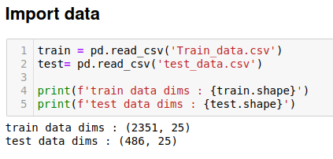
Data shape

Slide 5
Preprocessing
Label encoding
Standardisation

Slide 6
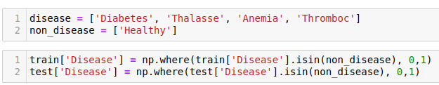
Label Encoding

Slide 7
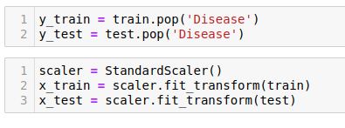
Standardisation

Slide 8
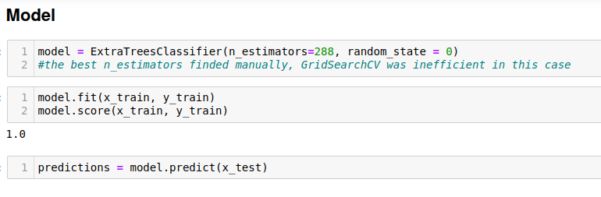
Model

Slide 9
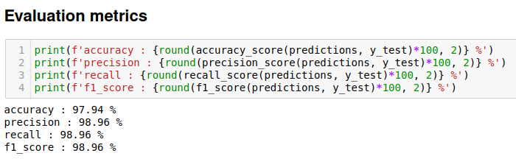
Metrics

Slide 10
Machine learning internship
Samuel MATIA

